Slide 1

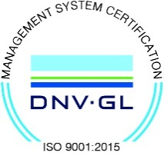
Subject Name :Microprocessor and Microcontroller Presentation Title: Application of 8051 in Medical
JEPPIAAR INSTITUTE OF TECHNOLOGY
“Self-Belief | Self Discipline | Self Respect”
Department of Electronics and Communication engineering
Team Members:
Students Name Reg.No:
1.Asfiya Nazz.A.I 210617106011
2.Avil Anisha.A 210617106012
3.Thilothaman 210617106080
4.Pradeep 210617106059
5.Murali 210617106053
6.Saravana Kumar 210617106071

Slide 2
Objective
8051 microcontroller is designed by Intel in 1981.
It is an 8-bit single chip microcontroller.
It is built with 40 pins DIP (dual inline package), 4kb of ROM storage and 128 bytes of RAM storage, 2 16-bit timers.
It consists of are four parallel 8-bit ports, which are programmable as well as addressable as per the requirement.

Slide 3
FEATURES
THE INTEL 8051 IS USED IN EMBEDDED SYSTEM
8 pin CPU
4k bytes ROM for the program\
128 bytes of RAM for variables
32 I\O lines (4 ports with 8 each)
2 timers and 1 serial port
6 interrupt source
low cost(10-15 cents per chip)

Slide 4
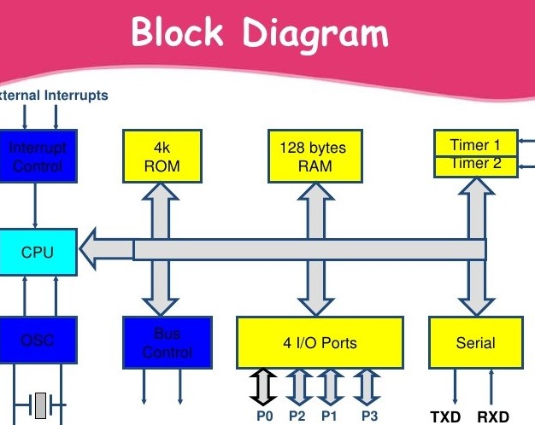
Block Diagram/ Work Flow/ Flow Chart

Slide 5
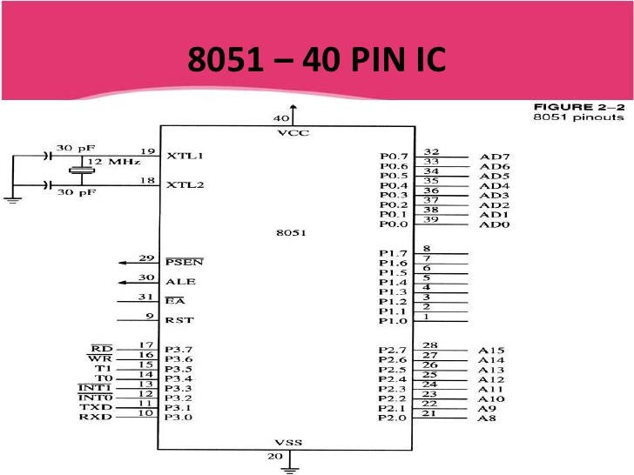
PIN DIAGRAM

Slide 6
Applications of 8051 in Medical are:
The best known application of 8051 microcontroller is a photoplethysmography
Photoplethysmography is the process of optically estimating the volumetric measurement of an organ. Pulse oximetry, cardiovascular monitoring, respiration detection, heart rate monitoring etc

Slide 7
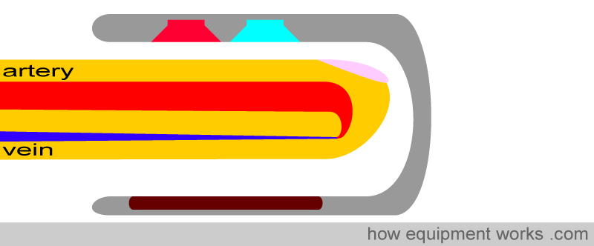
Pulse oximetry:
Pulse oximetry uses light to work out oxygen saturation.
There are two light one is infrared and another is red light sources which goes across the pulse oximeter probe and reaches the light detector.

Slide 8
Calculation of light absorbed
The amount of light absorbed is proportional to the concentration of Hb in the blood vessel.
The amount of light absorbed will be calculated by the 8051 microprocessor by using the Beer’s law.
Beer’s law states that Amount of light absorbed is proportional to the concentration of the light absorbing substance.
By measuring how much light reaches the light detector, the pulse oximeter knows how much light has been absorbed

Slide 9
Patient health monitoring system
The figure consists of various block such as GPS modem &GSM modem block interfaced to the microcontroller block,power supply block ,temperature sensor,EEPROM,LCD display and keypad.
If the temperature of the patient’s body increases beyond the preset temperature ,then temperature sensor sends the signal to the microcontroller
Thus, the microcontroller the GSM modem to send the sms to the concerned person based on the details stored in EEPROM memory
Similarly, the location details of the patient are also sent using the GPS modem and information is displayed on the LCD display.

Slide 10
Result & Discussion
Thus we have conclude that there are many microprocessor based chips and computer based on technology that are useful in medicine or medical sector

Slide 11
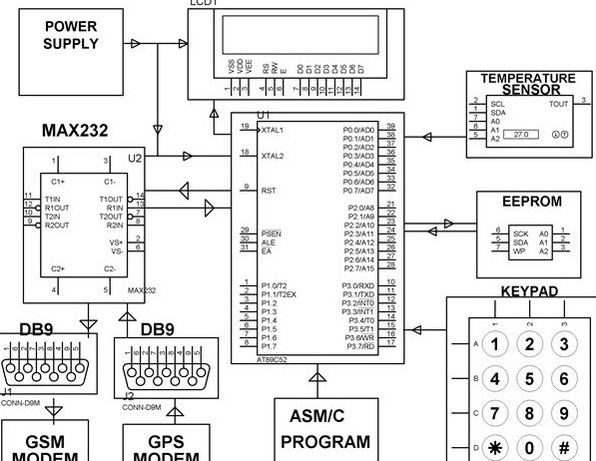
HEALTH MONITORING BLOCK DIAGRAM

Slide 12
Reference
http://www.edgefikits.com/blog/application -of-microcontroller-in-technology
http://www.watelectronics.com/8051-microcontroller-architecture/

